Slide 1
I2C

Slide 2
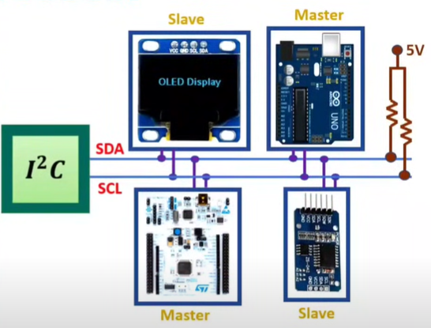
Basics of I2C Protocol
I2C is Inter Integrated Circuit Bus protocol.
Only Two lines are required for the communication using I2C protocol.
Here main advantage of I2C protocol is interfacing simplicity and with the use of Two lines we can interface 128 devices.
It is simple, low bandwidth protocol used for short range communication.
Most I2C devices operate up to speed of 400Kbps.
I2C lines:
Serial Data SDA
Serial Clock SCL
Both of these lines are pulled up at 5V, explains that no communication is happening.
Addressing is done by 7 bits to communicate with 128 devices at max.
Here number of devices is also limited by the total allowed bus capacitance of 400pF.
Master is initiating data transfer and controls the clock normally and the device being addressed is slave.

Slide 3

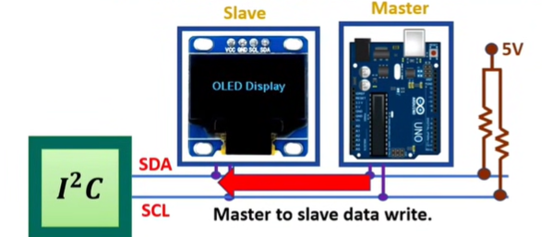

Data Transmission in I2C Protocol
Master to Slave Data Write in I2C Protocol

Slide 4
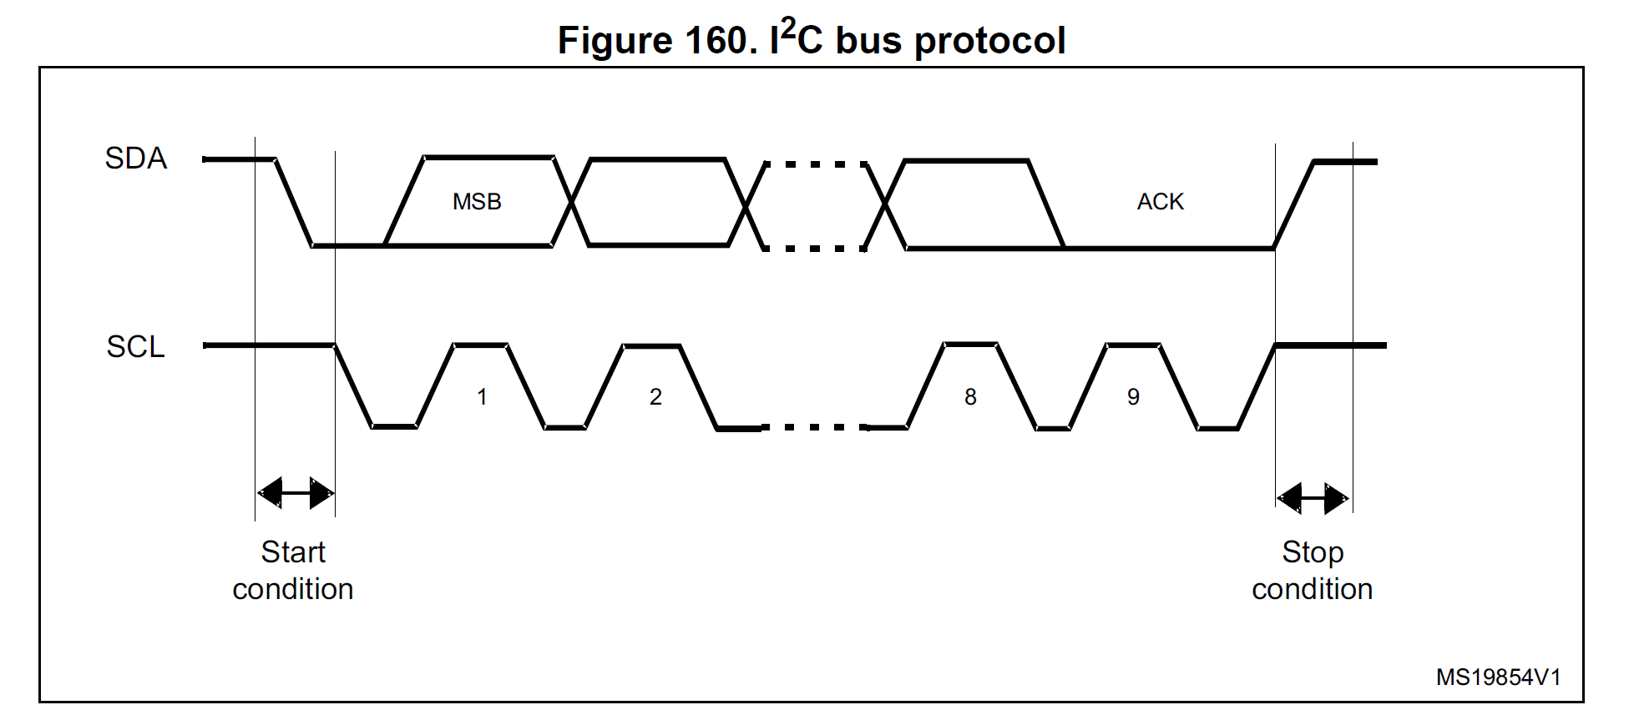
Working Principle
The transmission starts when a START condition is generated by the Master.
This condition occurs when SDA goes from a HIGH to a LOW state when SCL is HIGH.
Similarly, a STOP condition ends the transmission, when SDA goes from a LOW to a HIGH state when SCL is HIGH.

Slide 5
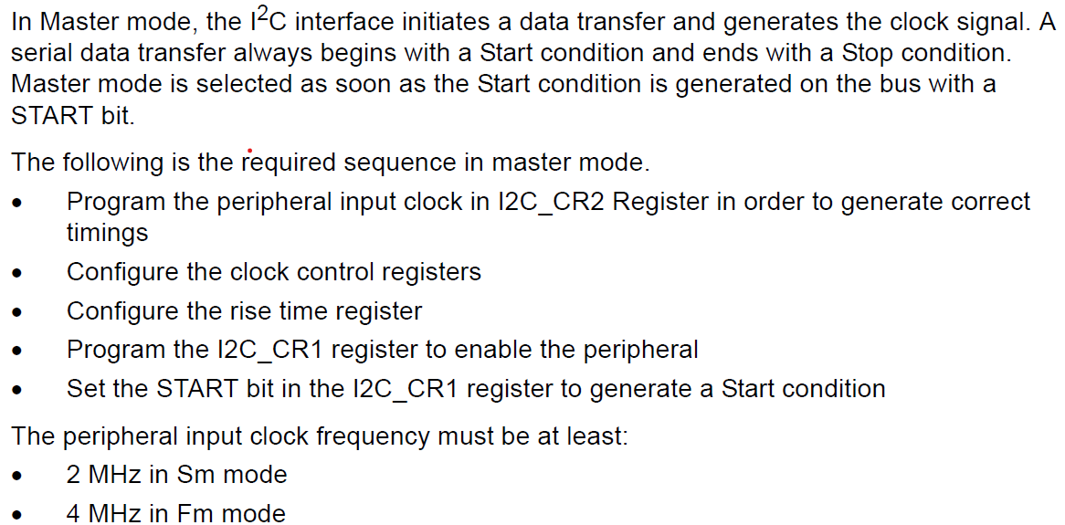
I2C master mode

Slide 6
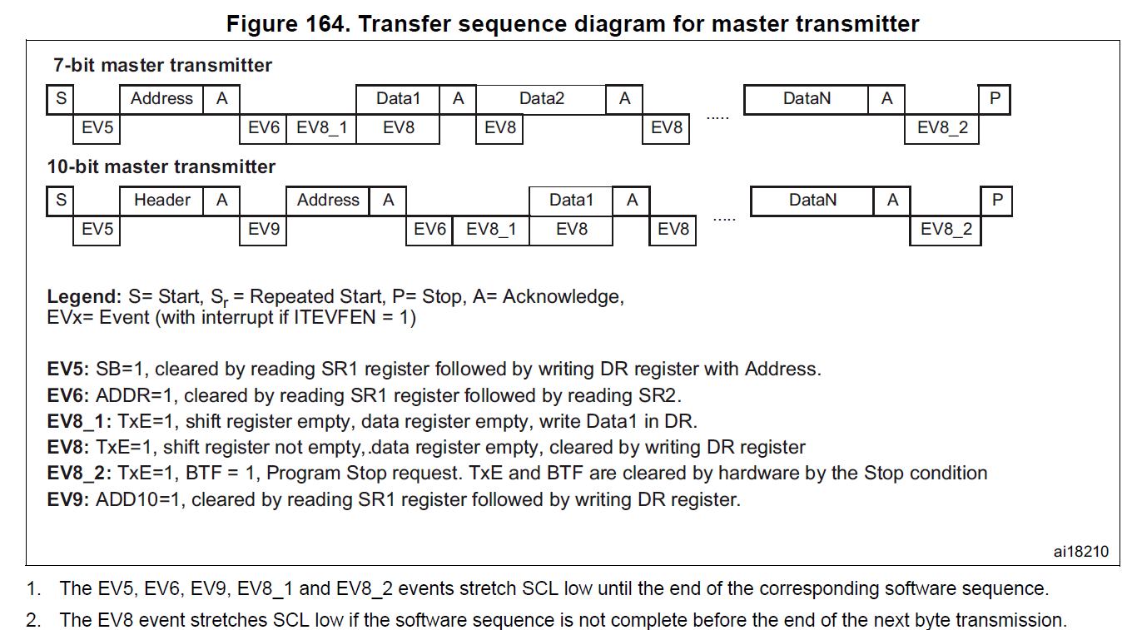
I2C master mode

Slide 7
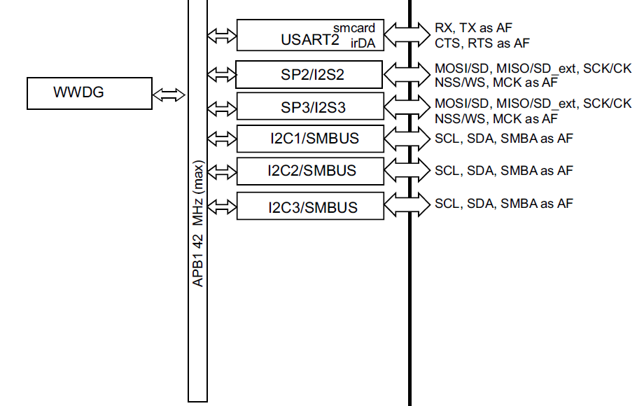
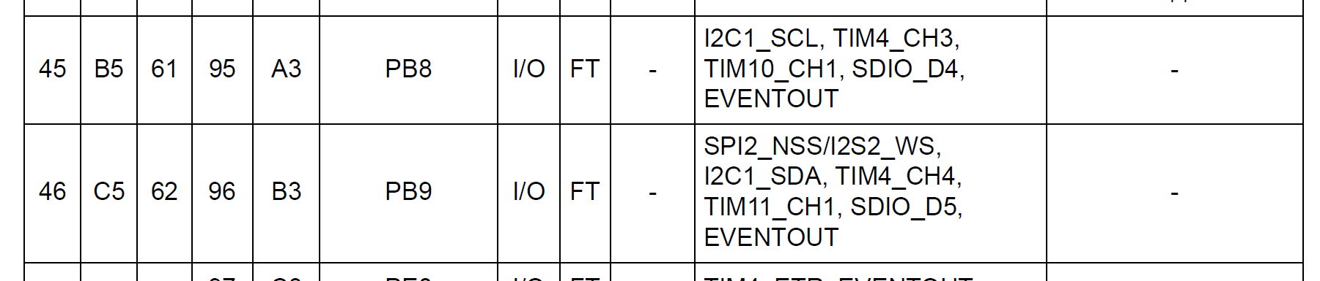
I2C Pin Configuration (GPIO Configuration)

Slide 8
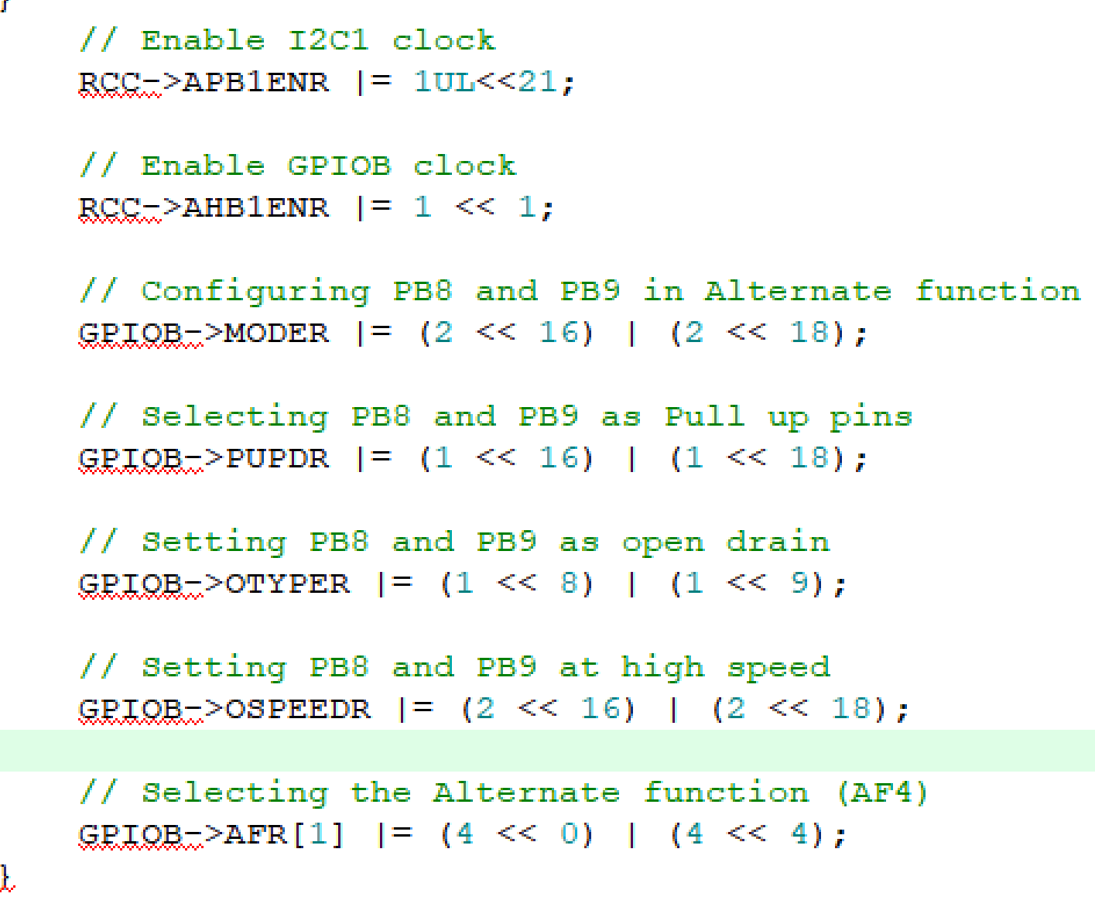
I2C Pin Configuration (GPIO Configuration)
Refer Datasheet for individual register configurations

Slide 9
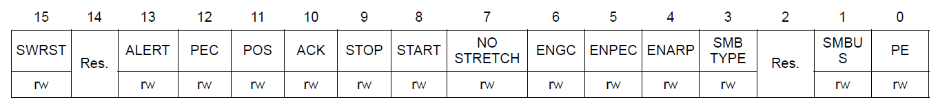
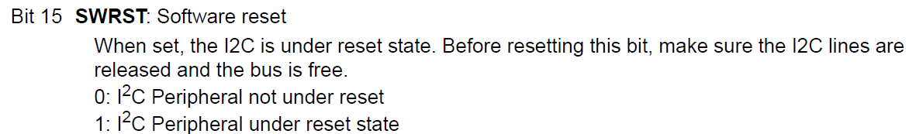
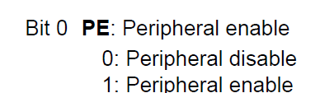
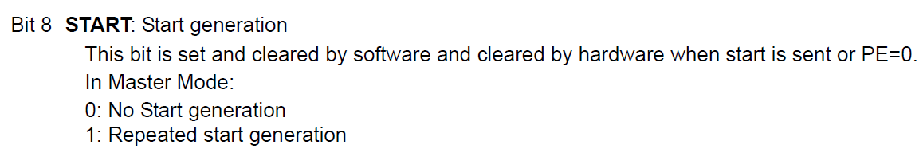
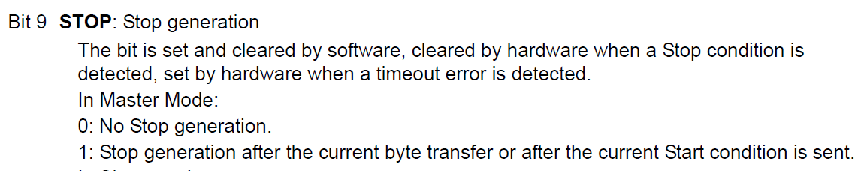
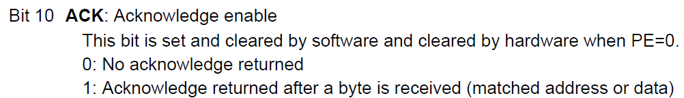
I2C Control register 1 (I2C_CR1)
// Reset I2C
I2C1->CR1 |= 1UL<<15;
I2C1->CR1 &= ~(1UL<<15);

Slide 10
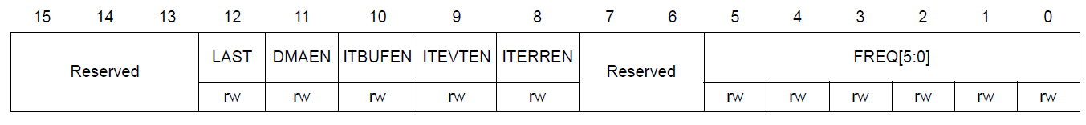
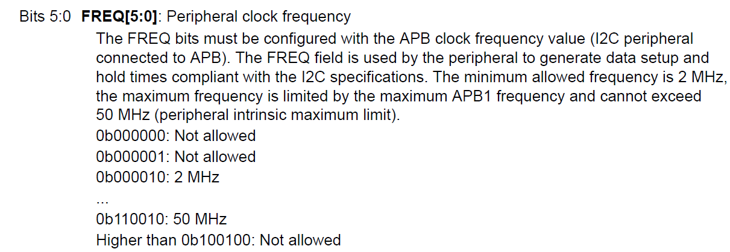
I2C Control register 2 (I2C_CR2)
// // Set I2C clock at 16MHz I2C
I2C1->CR2 |= (16<<0);

Slide 11
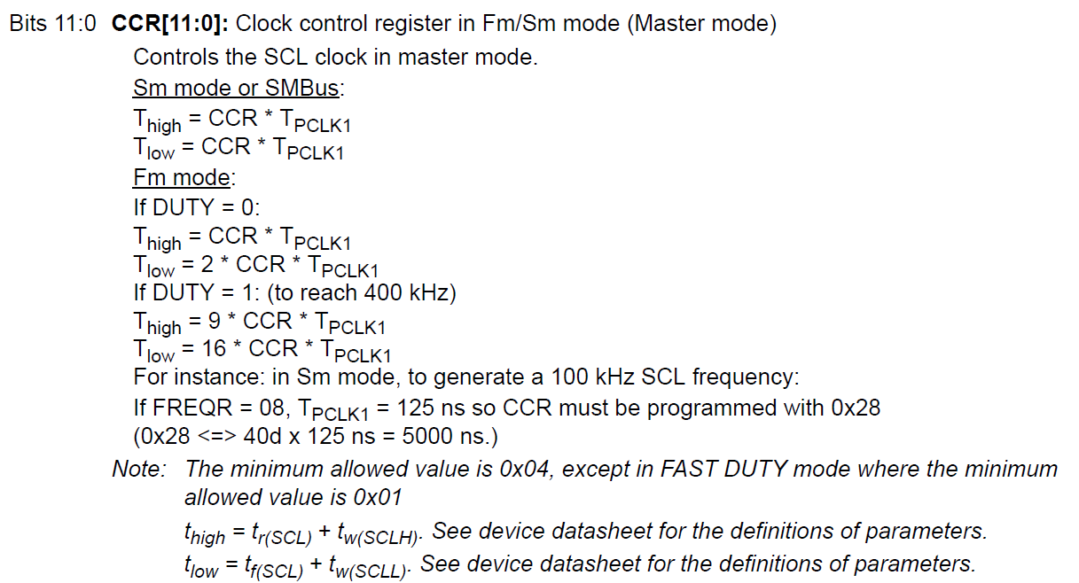
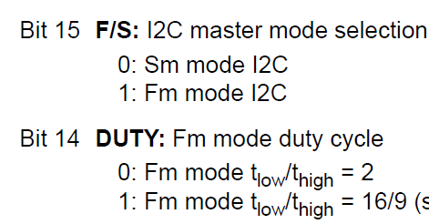
I2C Clock control register (I2C_CCR)

Slide 12
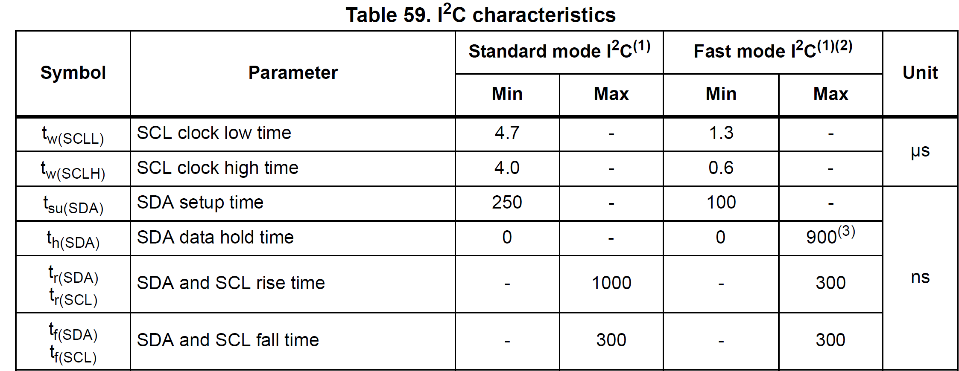

Slide 13
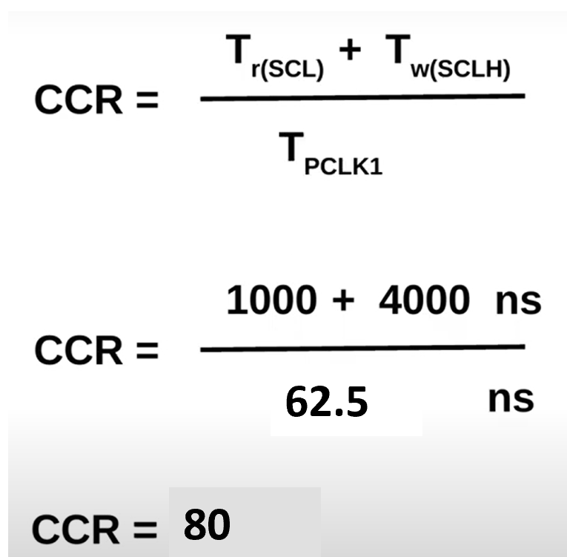
I2C Clock control register (I2C_CCR)
Our peripheral clock is running at 16 MHz, so
// Configure the clock control register
I2C1->CCR = 80;

Slide 14
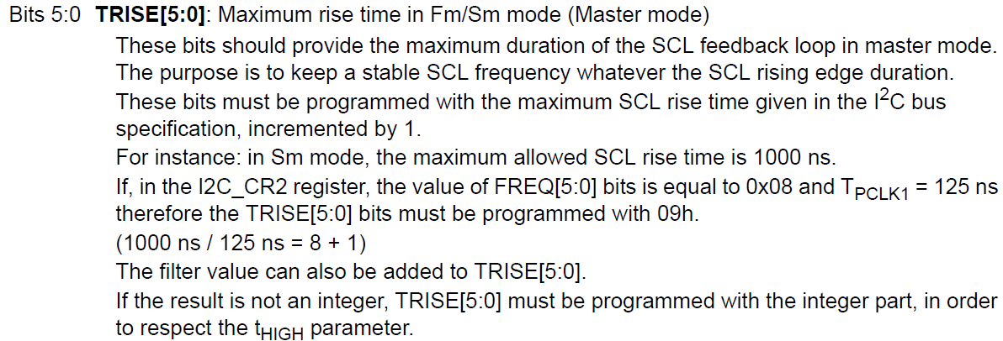
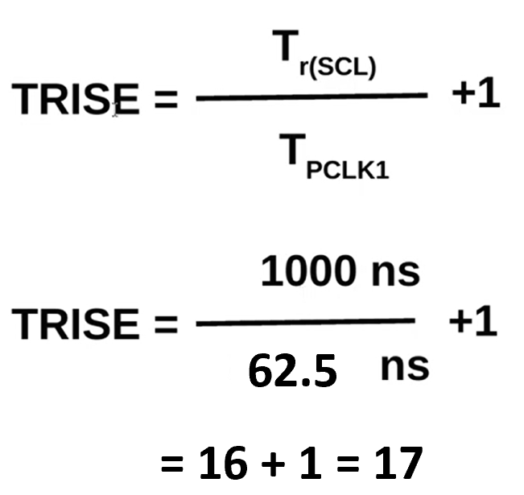
I2C TRISE register (I2C_TRISE)
// Configure the rise time register
I2C1->TRISE |= 17;

Slide 15
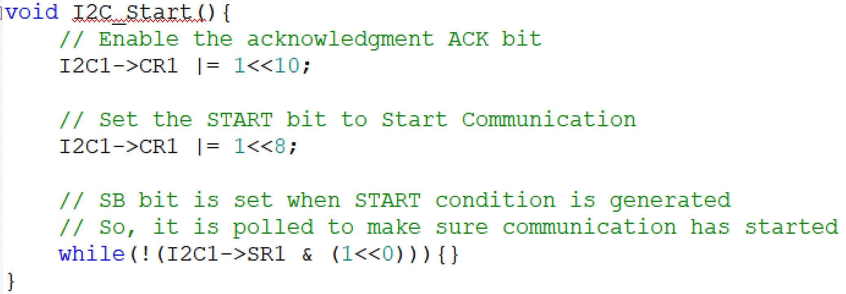
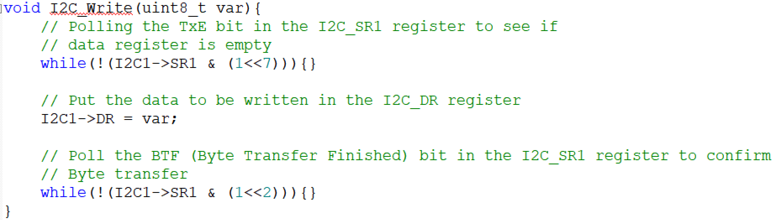
Configurations to transmit data
// Enable I2C
I2C1->CR1 |= 1<<0;

Slide 16
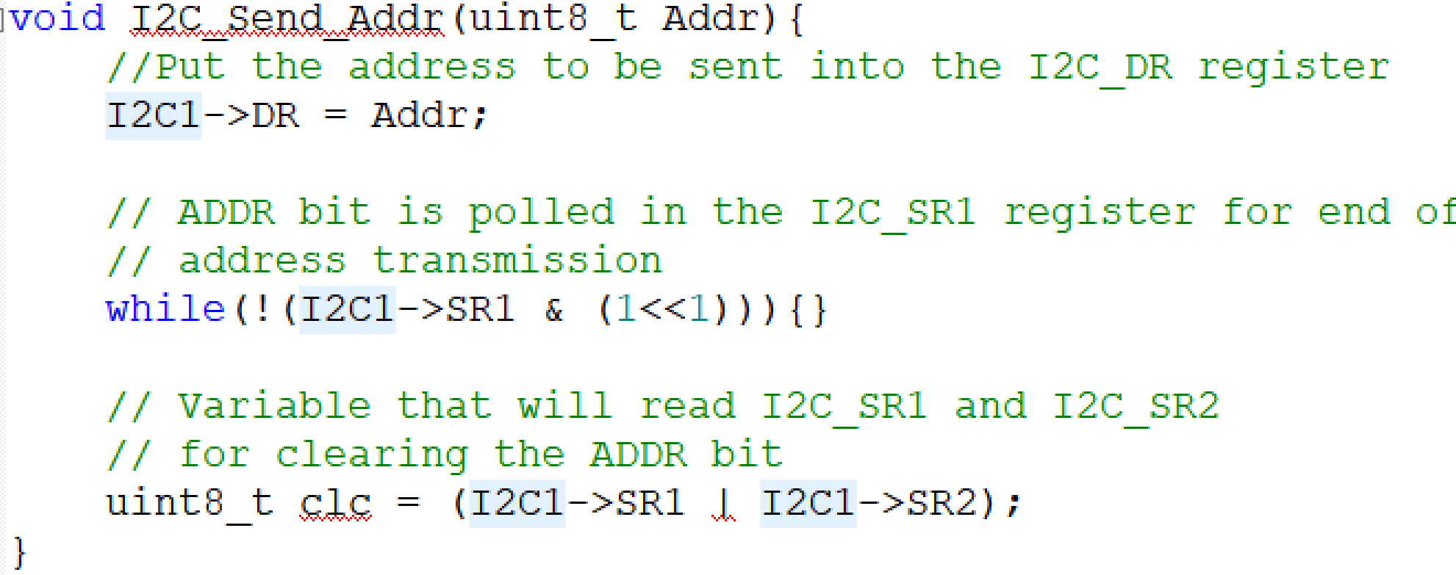
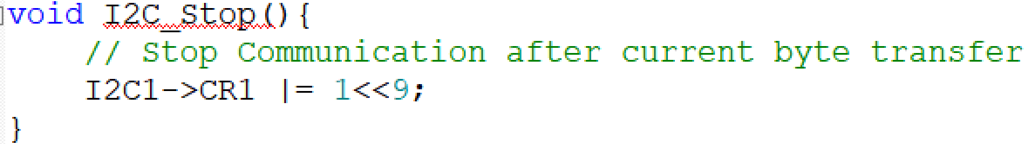
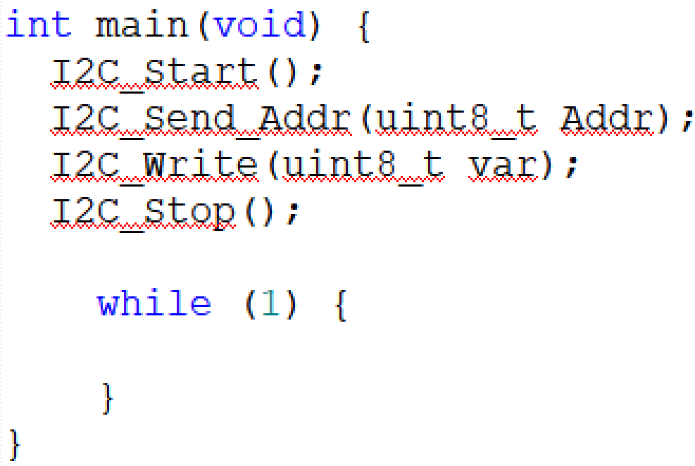
Configurations to transmit data

Slide 17
Thank You

